Slide 1
update dan delete record

Slide 2
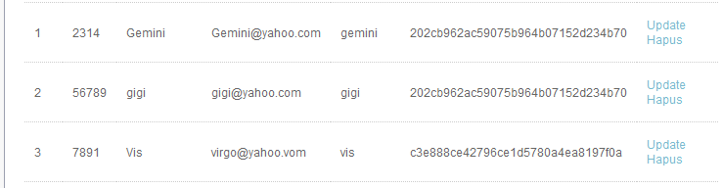

Slide 3
<?
//update mhs
include "koneksi.php";
$npm = $_GET['id'];
$q1 = "SELECT * FROM tbllogin where id = '$id'";
$tampil = mysql_query($q1);
$baris = mysql_fetch_array($tampil);
?>
<?php
include "koneksi.php";
if(isset($_POST['button']))
{
$npm = antiinjection($_POST['id']);
$nama = antiinjection($_POST['namalengkap']);
$email = antiinjection($_POST['email']);
$sqlupdate = "UPDATE tblmhs SET nama = '$nama', email = '$email‘ WHERE id = '$id'";
$updateuser = mysql_query($sqlupdate);
if($updateuser)
{
?>
<script type="text/javascript">
alert("Data User Sudah Terupdate")
window.location = "http://localhost/virgokp/user.php";
</script>
<?
} } ?>

Slide 4
<table width="100%" border="1" cellspacing="0" cellpadding="0">
<tr>
<td align="center">No.</td>
<td align="center">NPM</td>
<td align="center">NAMA</td>
<td align="center">ALAMAT</td>
<td align="center">Action</td>
</tr>

Slide 5
<?php
include"koneksi.php";
$sql_view_mhs = "SELECT * from tblmhs";
$tampil = mysql_query($sql_view_mhs);
$no = 1;
while ($baris = mysql_fetch_array($tampil))
{
?>

Slide 6
<tr>
<td><? echo $no; ?></td>
<td><?=$baris[0];?></td>
<td><?=$baris[1];?></td>
<td><?=$baris[2];?></td>
<td><? echo "<a href = edite_mhs.php?npm=$baris[0]> Update </a> ";?> <? echo "&nbsp";?> <? echo "<a href = delete_npm.php?npm=$baris[0]> Hapus </a> ";?>
</td>
</tr>
<?php
$no++;
}
?>
</table>

Slide 7
<form method="post" action="<?php $_SERVER['PHP_SELF'];?>" name="forminputuser">
<table width="100%" border="0" cellspacing="1" cellpadding="1">
<tr>
<td width="25%">&nbsp;</td>
<td width="3%">&nbsp;</td>
<td width="72%">&nbsp;</td>
</tr>
<tr>
<td>NPM</td>
<td>:</td>
<td><input name=“npm" type="text" id=“npm" value="<?=$baris[0];?>" readonly="readonly" /></td>
</tr>
<tr>
<td>Nama Lengkap</td>
<td>:</td>
<td><input name=“nama" type="text" id="nama" value="<?=$baris[1];?>" size="50" maxlength="50" /></td>
</tr>
<tr>
<td>e-mail</td>
<td>:</td>
<td><input name="email" type="text" id="email" value="<?=$baris[2];?>" /></td>
</tr>
</table>
</form>

Slide 8
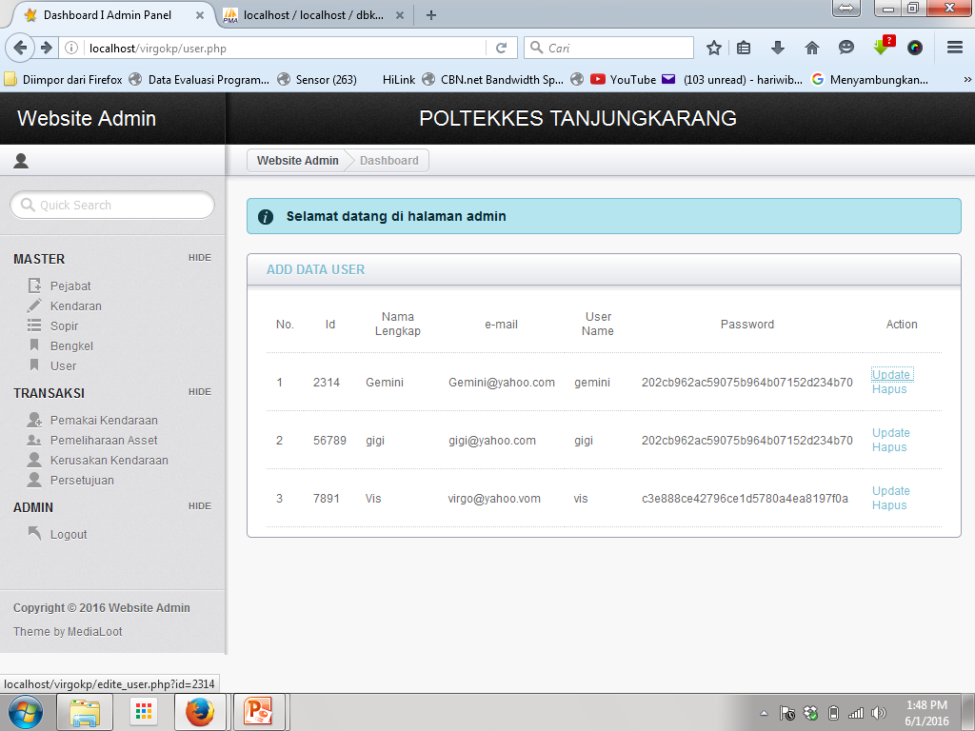

Slide 9
<? echo "<a href = edite_mhs.php?npm=$baris[0]> Update </a> ";?>

